Slide 1
MACHINE JOB
SCHEDULING
Sprint-1
PRESENTED BY:
Kalyani Sonawane
Hitesh Sonawane
Keerthi Pothrapally
Praneeth Gowrineni
Vamshi Jindam

Slide 2
CONTENTS
Introduction
Application Solution
Workflow
Flow Of Code
Testing
Conclusion

Slide 3
INTRODUCTION
The developed application will process various files in parallel manner and reduce the time for completion of processes by converting them into multiple small single-sequence streams called "threads."

Slide 4
DAY 1 TO 4
01
02
SRS
DESIGN
03
04
CODING
TESTING
Software Requirements Specification
Understanding the problem and
create pseudo code and DFD0 and DFD1 for the same
Developing our logic using C language
Test our developed application using various sunny and rainy test cases

Slide 5

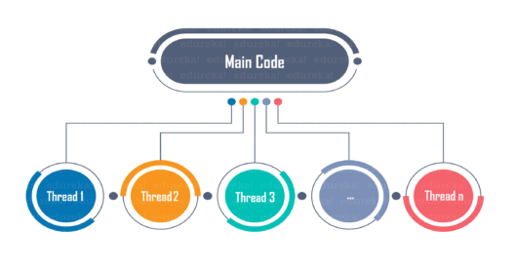
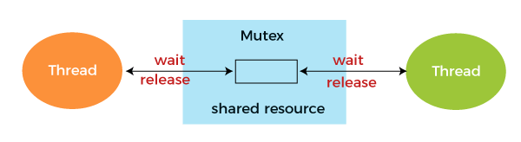
Application Solution
Linked List
Multithreading
Mutex

Slide 6
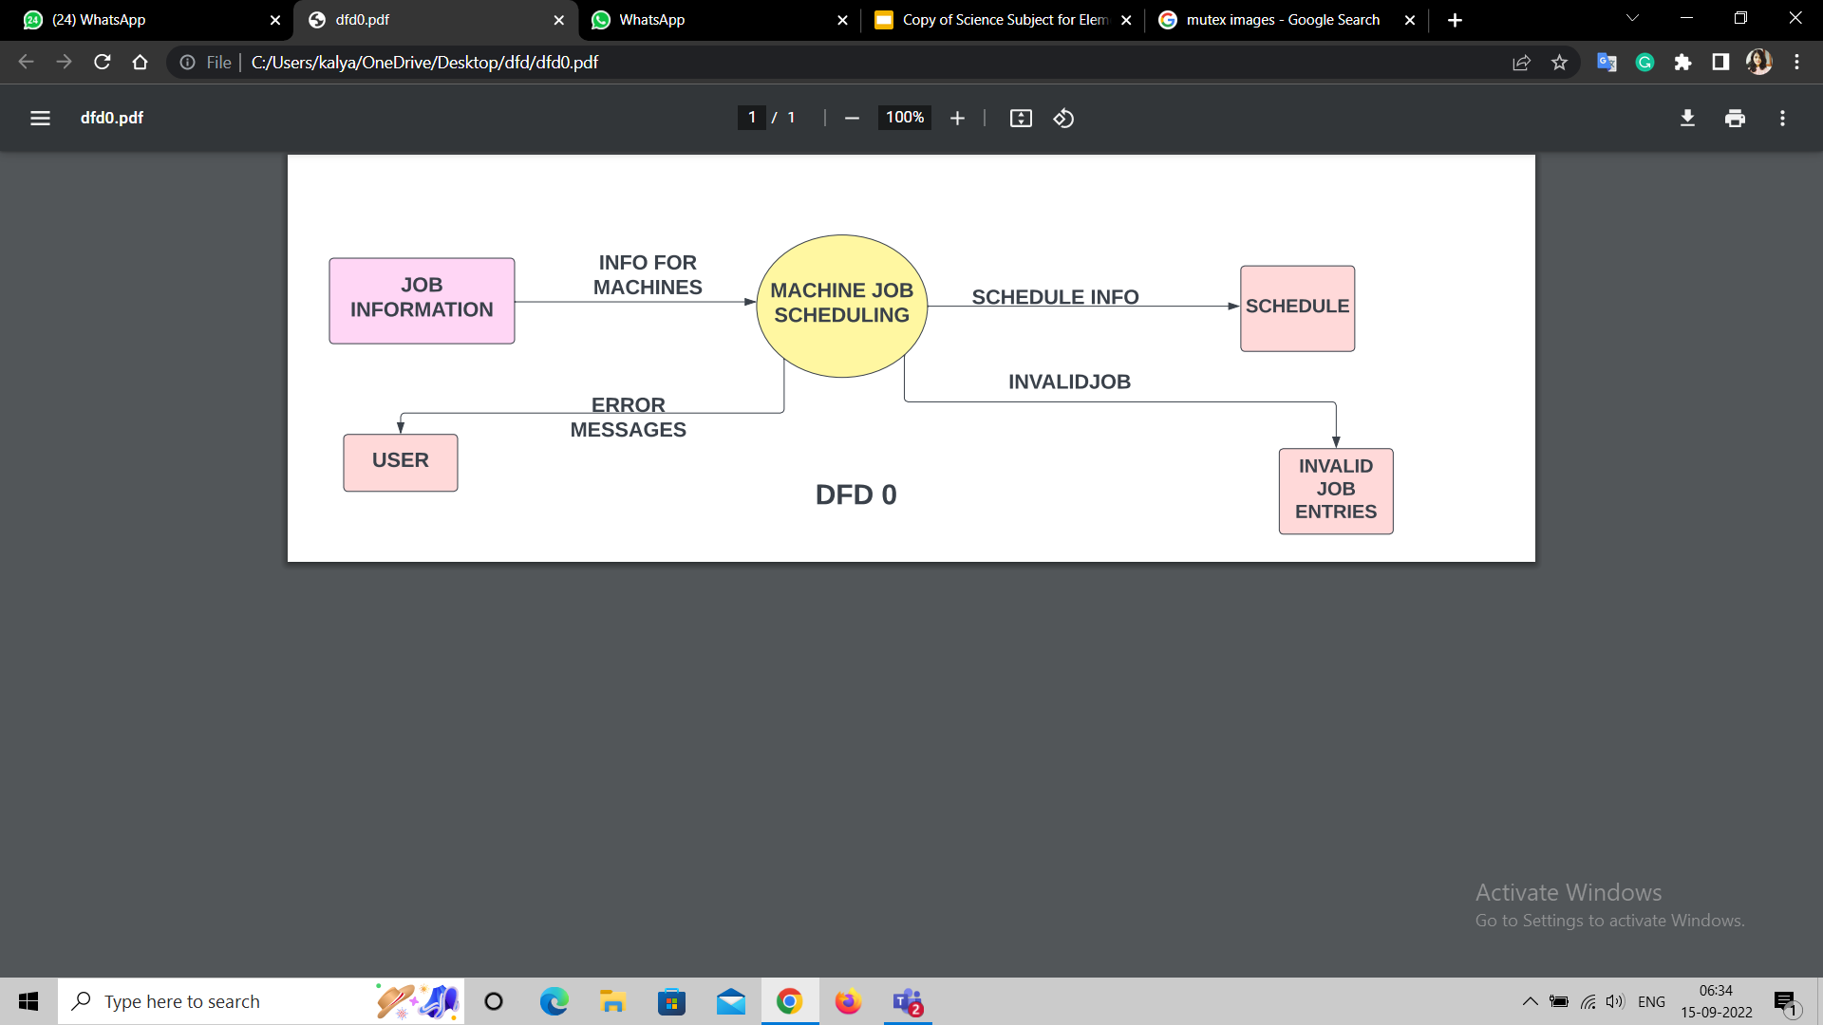
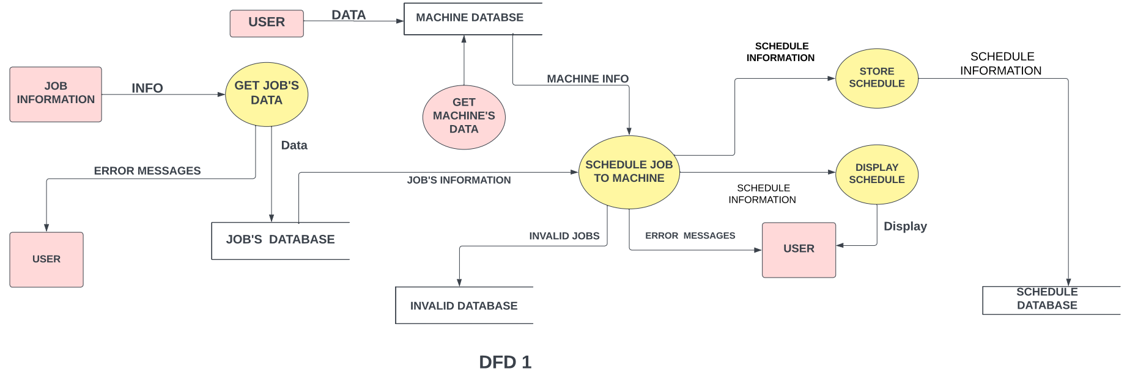
Workflow

Slide 7
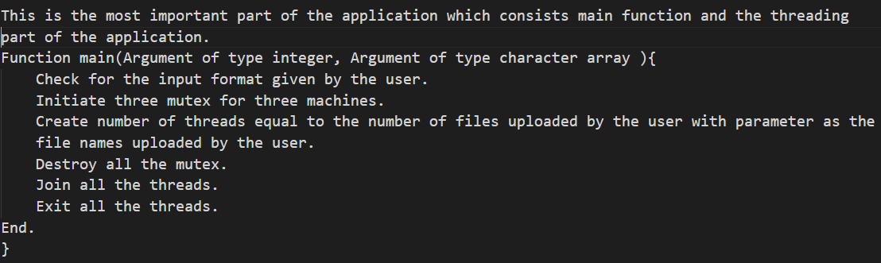
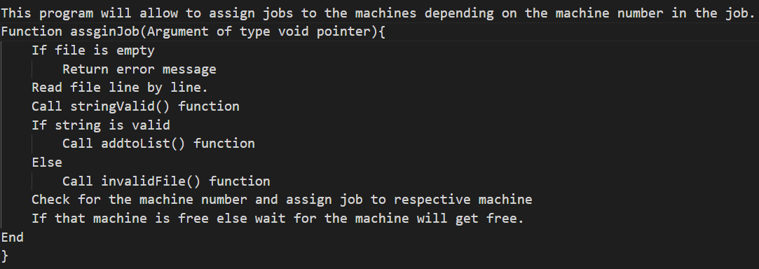
main.c
assignJob.c
FLOW OF CODE

Slide 8
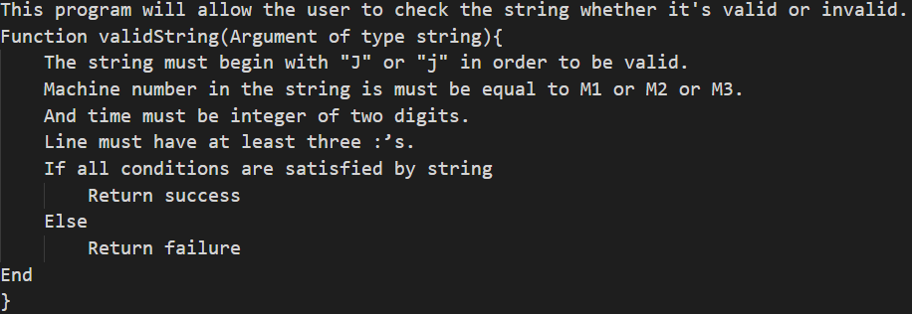
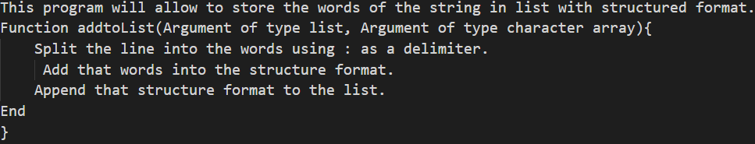
stringvalid.c
addTolist.c

Slide 9
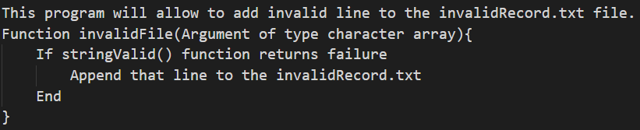
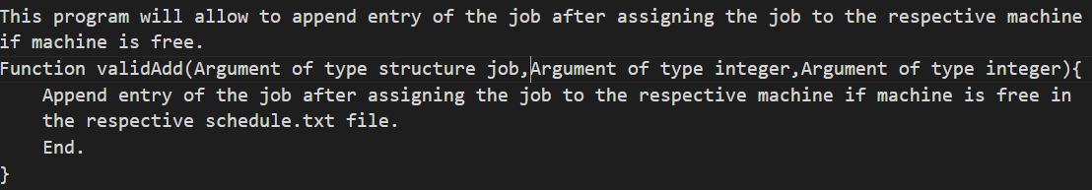
invalidFile.c
validAdd.c

Slide 10
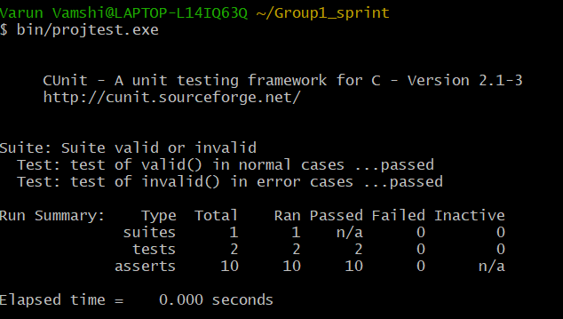
UNIT TESTING
CUNIT REPORT →
Example of sunny test case:
J001:Surface painting:M1:30
Example of rainy test case:
ABCD:Pipe bending:M1:45:Expert Accessories

Slide 11


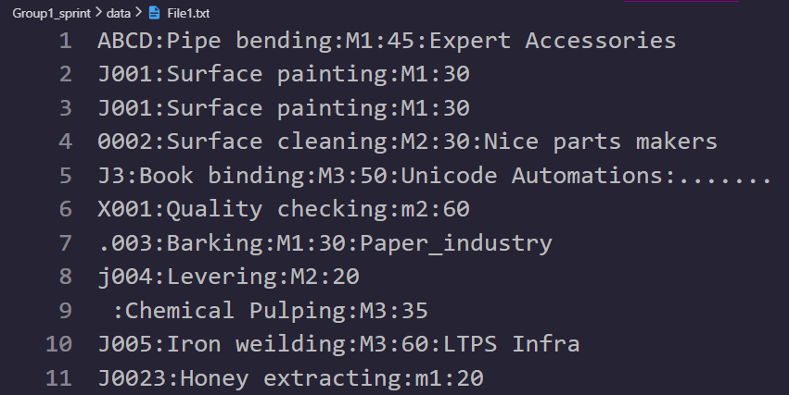
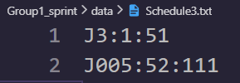
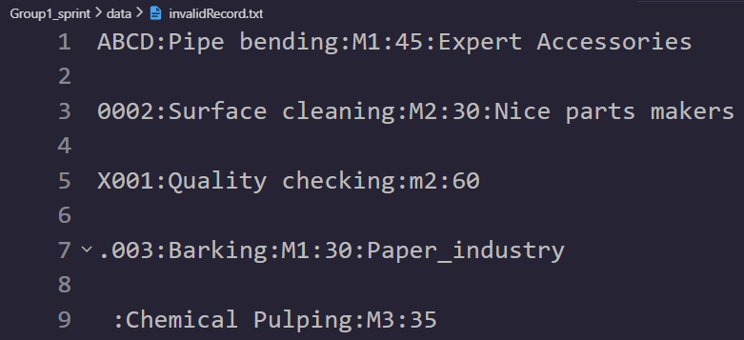
Valid cases:
User gives the input file:
bin/sprint.exe data/File1.txt
Invalid cases:

Slide 12
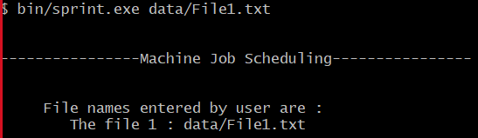
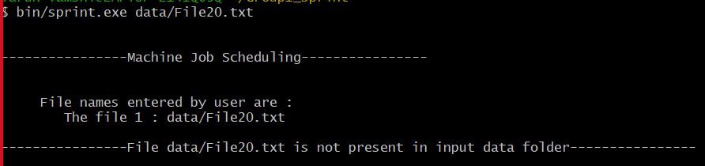
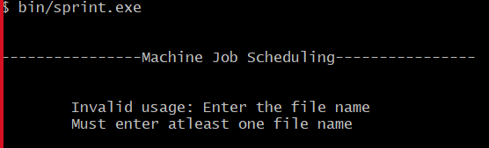
INTEGRATION TESTING
: User has provided File1.txt(which is not empty and present in the data folder)
: User has provided File20.txt(which is not present in the data folder)
: When number of arguments is less than 2, User has not provided the file.

Slide 13
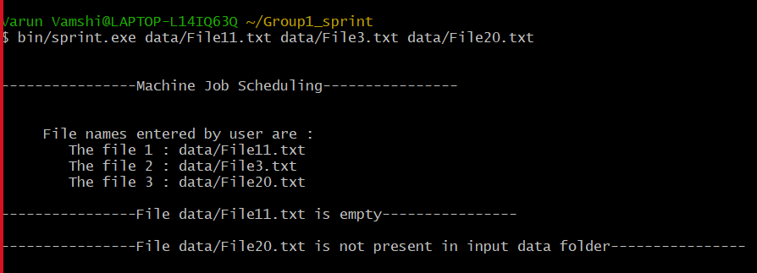
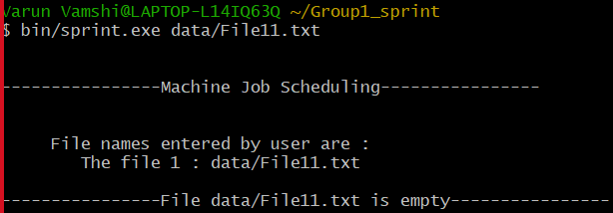
: User has provided File11.txt(which is empty).
: User has provided File3.txt(which is not empty and present in the data folder).
: User has provided File20.txt(which is not present in data folder).
: User has provided File11.txt(which is empty)

Slide 14
CONCLUSION
Successfully launched and implemented the Machine job scheduling application. This application is able to perform operations on various files parallely and give expected results with more efficiency and less time as compared to traditional method.

Slide 15
THANK YOU

